Slide 1

FAST API
Deployment

Slide 2
FastAPI
FastAPI is a modern, fast (high-performance) web framework for building APIs with Python.
It is used to create backend services, machine learning model APIs, and full applications.
FastAPI is built on ASGI (Asynchronous Server Gateway Interface) and uses uvicorn. Because of this, it is extremely fast — much faster than Flask or Django REST Framework.

Slide 3
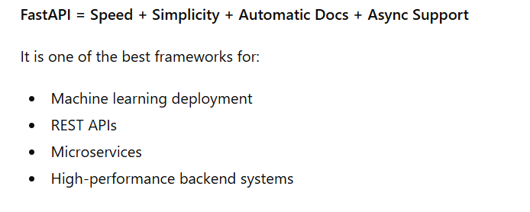

Slide 4
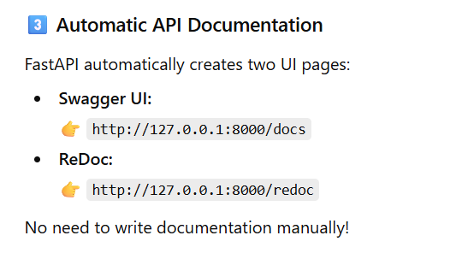

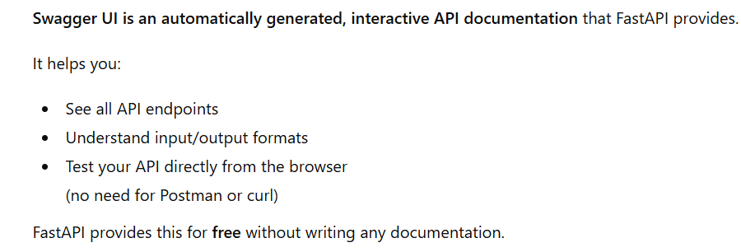

Slide 5
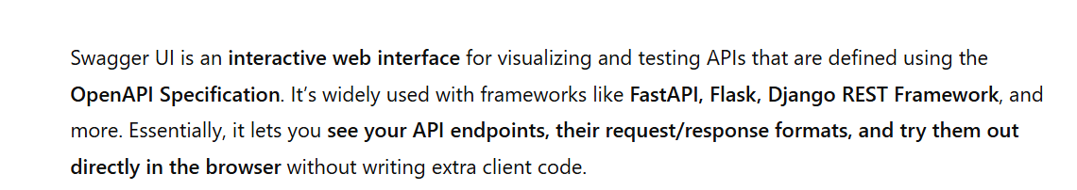

Slide 6
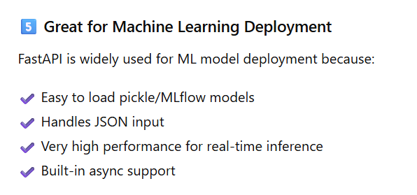

Slide 7
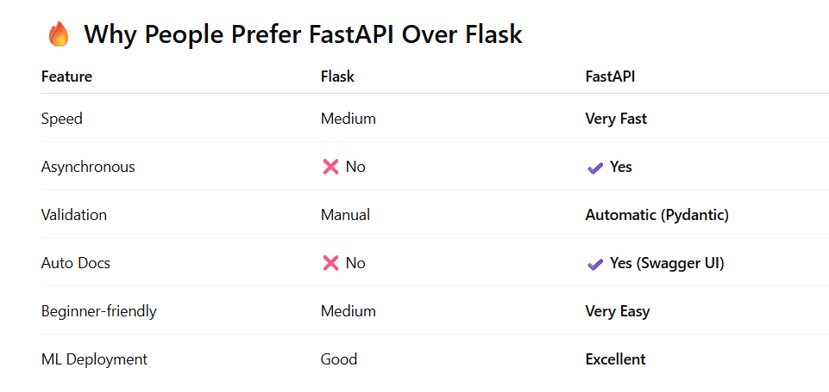

Slide 8

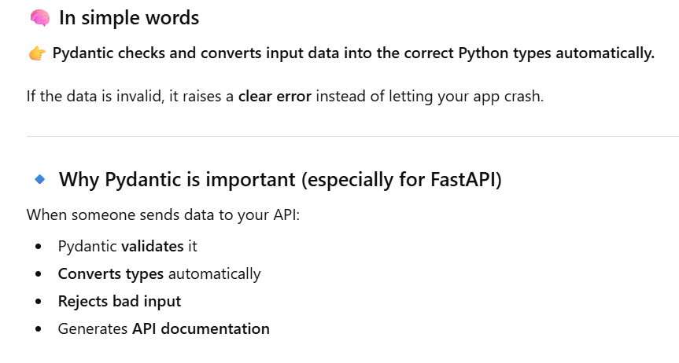
Pydantic

Slide 9
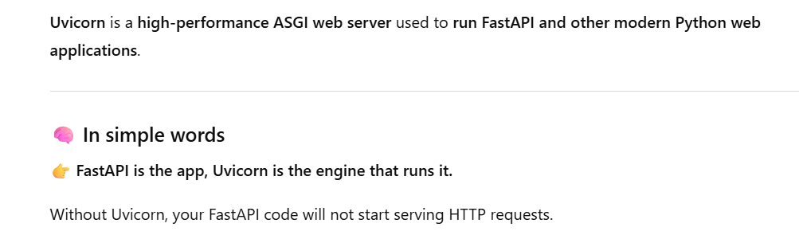
Uvicorn

Slide 10
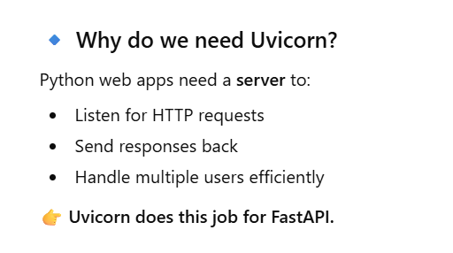

Slide 11
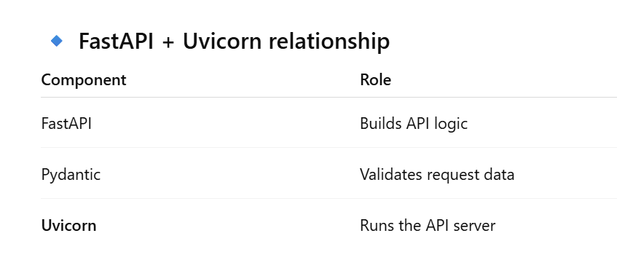

Slide 12
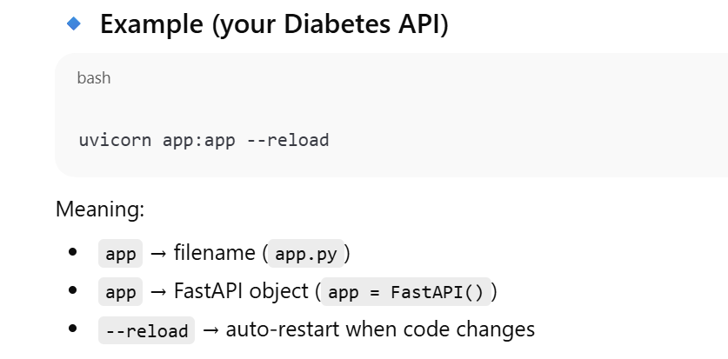

Slide 13
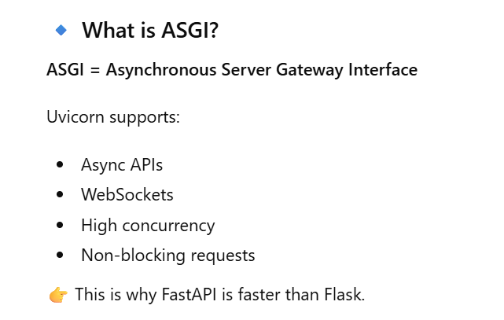

Slide 14
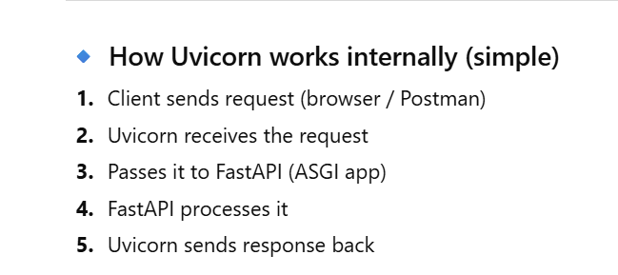

Slide 15
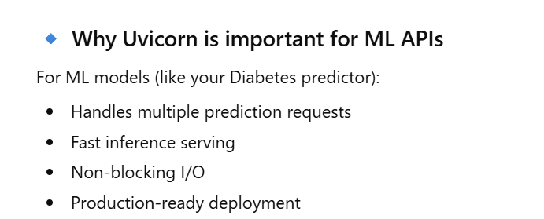

Slide 16
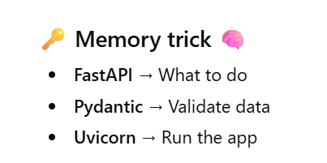

Slide 17
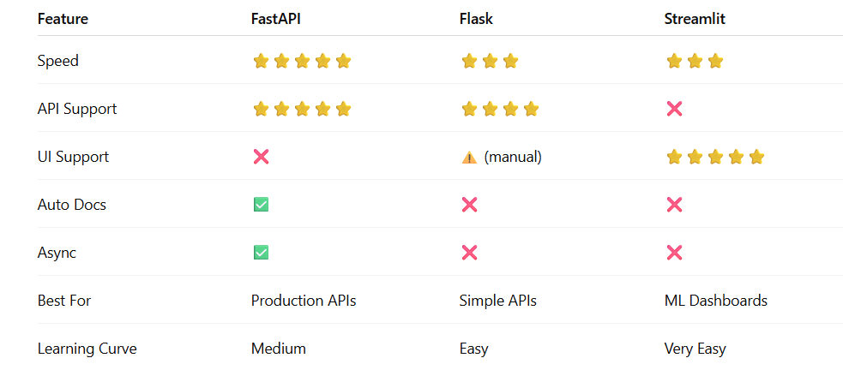

Slide 18
Program

Slide 19
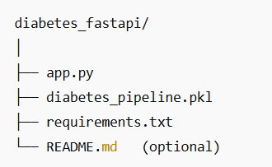
Project Structure

Slide 20

1. Train model

Slide 21
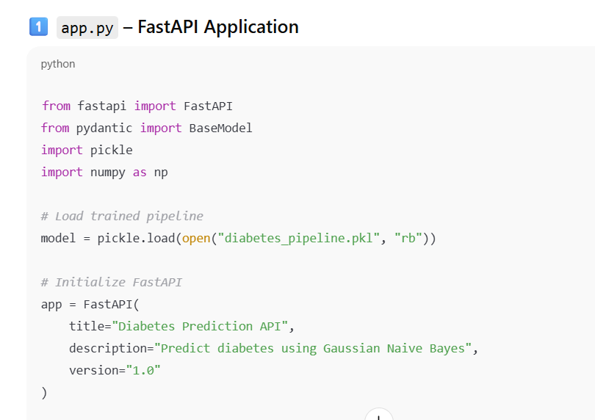
2. app.py

Slide 22
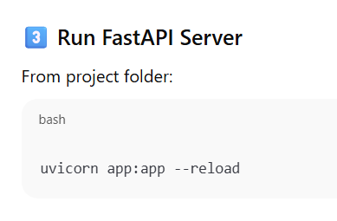

Slide 23
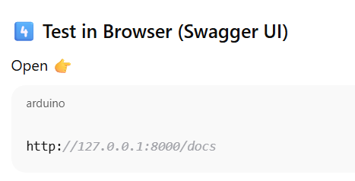

Slide 24
Sample Input
{
"Pregnancies": 6,
"Glucose": 148,
"BloodPressure": 72,
"SkinThickness": 35,
"Insulin": 0,
"BMI": 33.6,
"DiabetesPedigreeFunction": 0.627,
"Age": 50
}

